Slide 1
Introduction to Programming with Python
Vineet Bansal
Research Software Engineer, Center for Statistics & Machine Learning
vineetb@princeton.edu
August 20-24, 2018

Slide 2
Tuples
Use ‘(‘ and ‘)’ instead of ‘[‘ and ‘]’
>>> t = (1, 2, 3)
Immutable version of List.
Indexing/Slicing works the same
Cannot insert/delete/append once created
Fast! (items stored at consecutive memory locations)

Slide 3
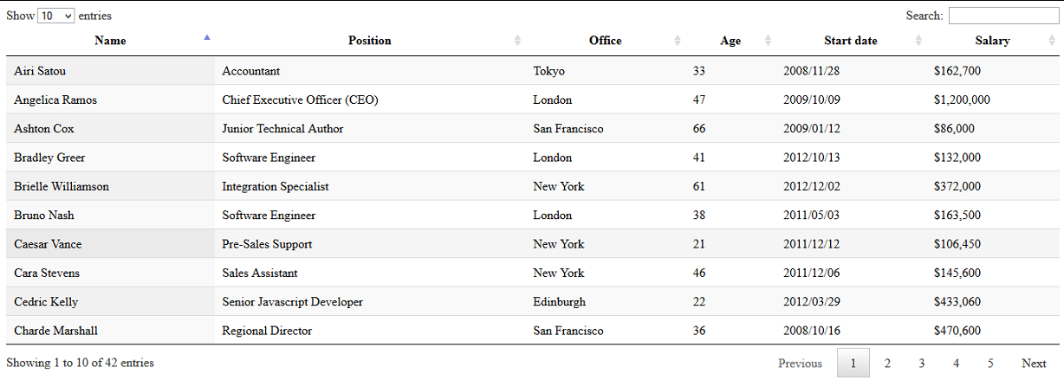
Tuples
Why do we need tuples at all?
Useful when a sequence of items should not be altered.
Each row is a tuple
We have a list of
rows

Slide 4
Tuple Packing/Unpacking
The ‘(‘ and ‘)’ can be omitted during assignment. Python ‘packs’ the individual items into a tuple.
>>> t = 1, 2, 3
>>> type(t)
<class ‘tuple’>
Similarly, tuple unpacking is a common way of assigning multiple variables in one line:
>>> a, b, c = 97, 98, 99
>>> b
98

Slide 5
Tuple Packing/Unpacking
This allows us to write the world’s shortest code to swap two variables:
>>> a = 1
>>> b = 10
>>> a, b = b, a
>>> a
10
>>> b
1

Slide 6
Dictionaries
Coming Soon..

